Slide 1
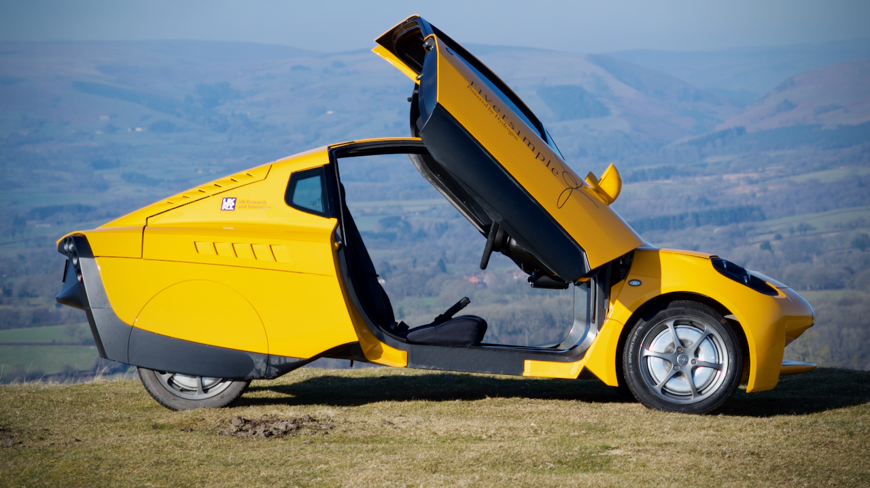
The role of hydrogen in sustainable transport
Institute of Directors, 26th April 2023

Slide 2
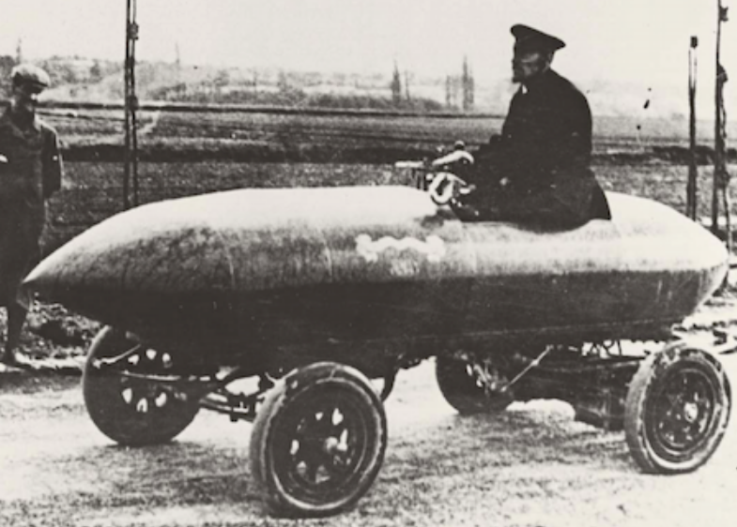
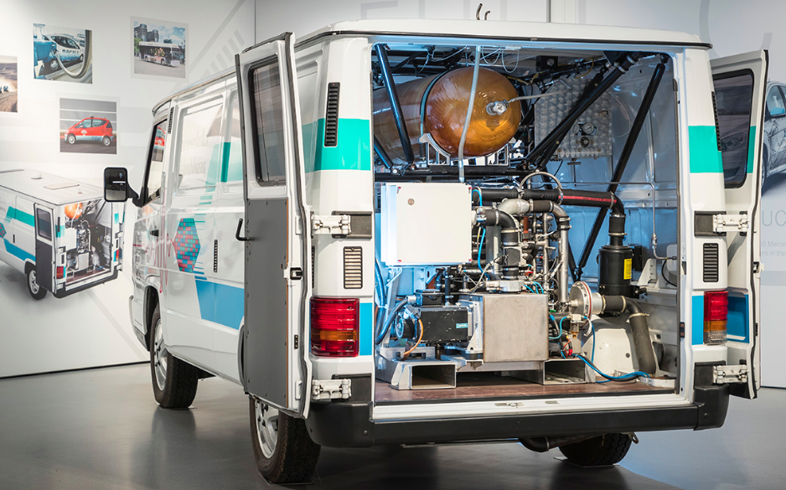
Camille Jenatzy in La Jamais Contente, a BEV, breaking the Land Speed Record at 105km/h in 1899
April 2023
Mercedes Benz Necar 1, 1994

Slide 3
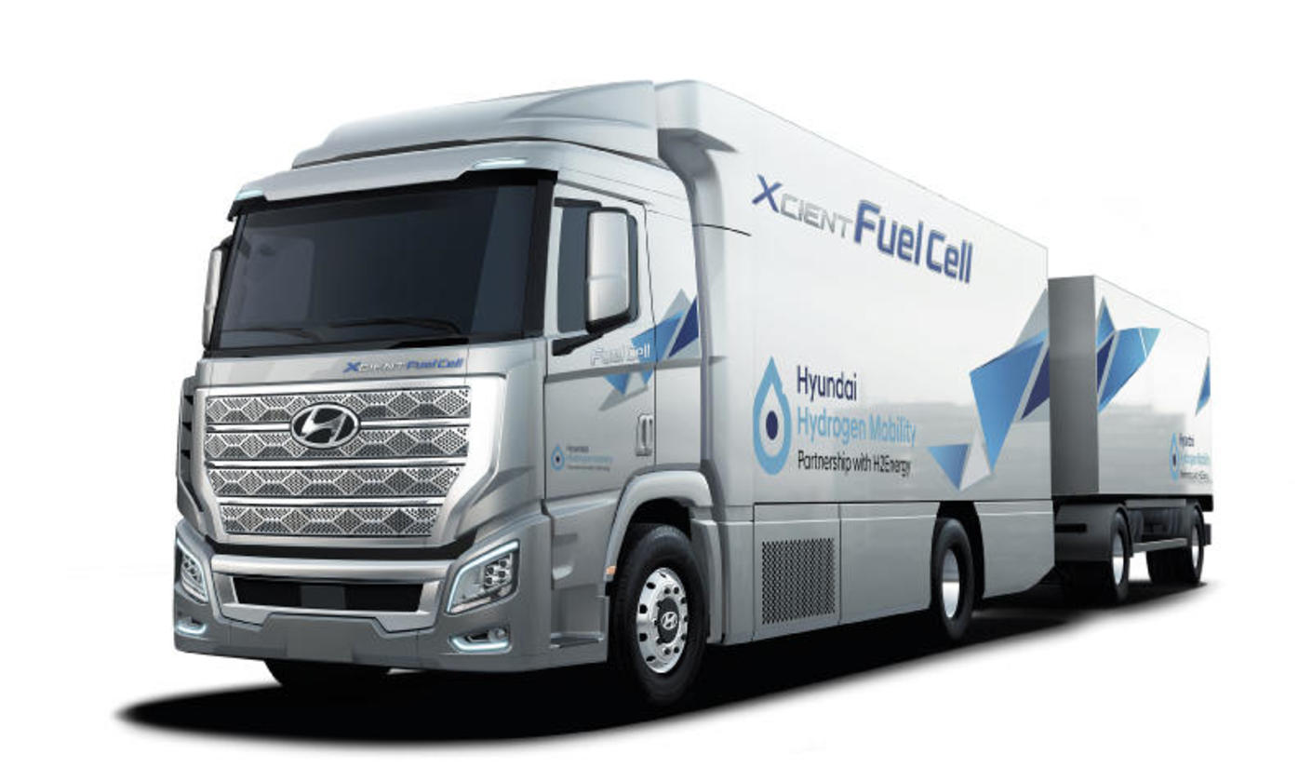
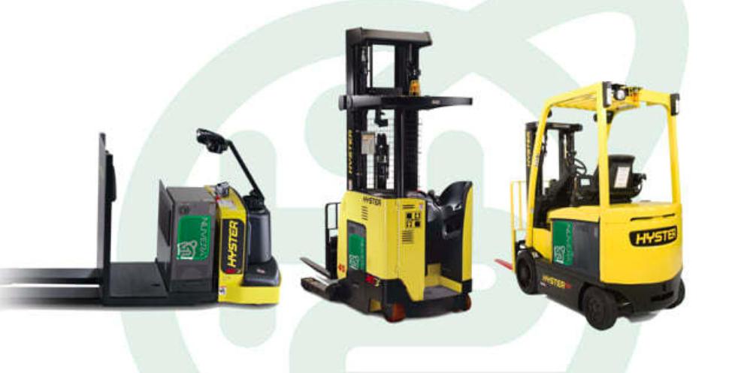
Batteries or Hydrogen?
– The wrong question!
April 2023
Criteria for choice between BEV and FCEV:
Range
Utilisation
Choice is independent of size:
Heavy goods vehicles (HGVs)
Buses
Passenger cars
Materials handling – forklifts

Slide 4
MILFORD HAVEN: ENERGY KINGDOM
Riversimple Rasa – benefits of a lightweight architecture
700 bar
ICE
BEV
FCEV
Ford Fiesta
Hyundai Nexo
Toyota Mirai
Mercedes-Benz EQS 450+
April 2023
Next Gen
Riversimple
vehicles
VW ID.4 Pro
Tesla
Model X LR
Tesla
Model 3 LR
Mercedes-AMG EQS 53 4Matic+
Range in miles (manufacturer declared – WLTP)
350 bar
Nissan Leaf
Jaguar I-Pace
Smart ForFour EQ
UK example: Total Cost of Ownership (TCO) for 3 years in GBP
There is a close correlation between price and range of a BEV; a lot more money buys a little bit more range.
The Ford Fiesta has been the best-selling vehicle in the UK for a decade; there is no BEV on the market that delivers the same range at any price.
Riversimple’s powertrain architecture and business model offers the range of a Fiesta at an equivalent price.

Slide 5
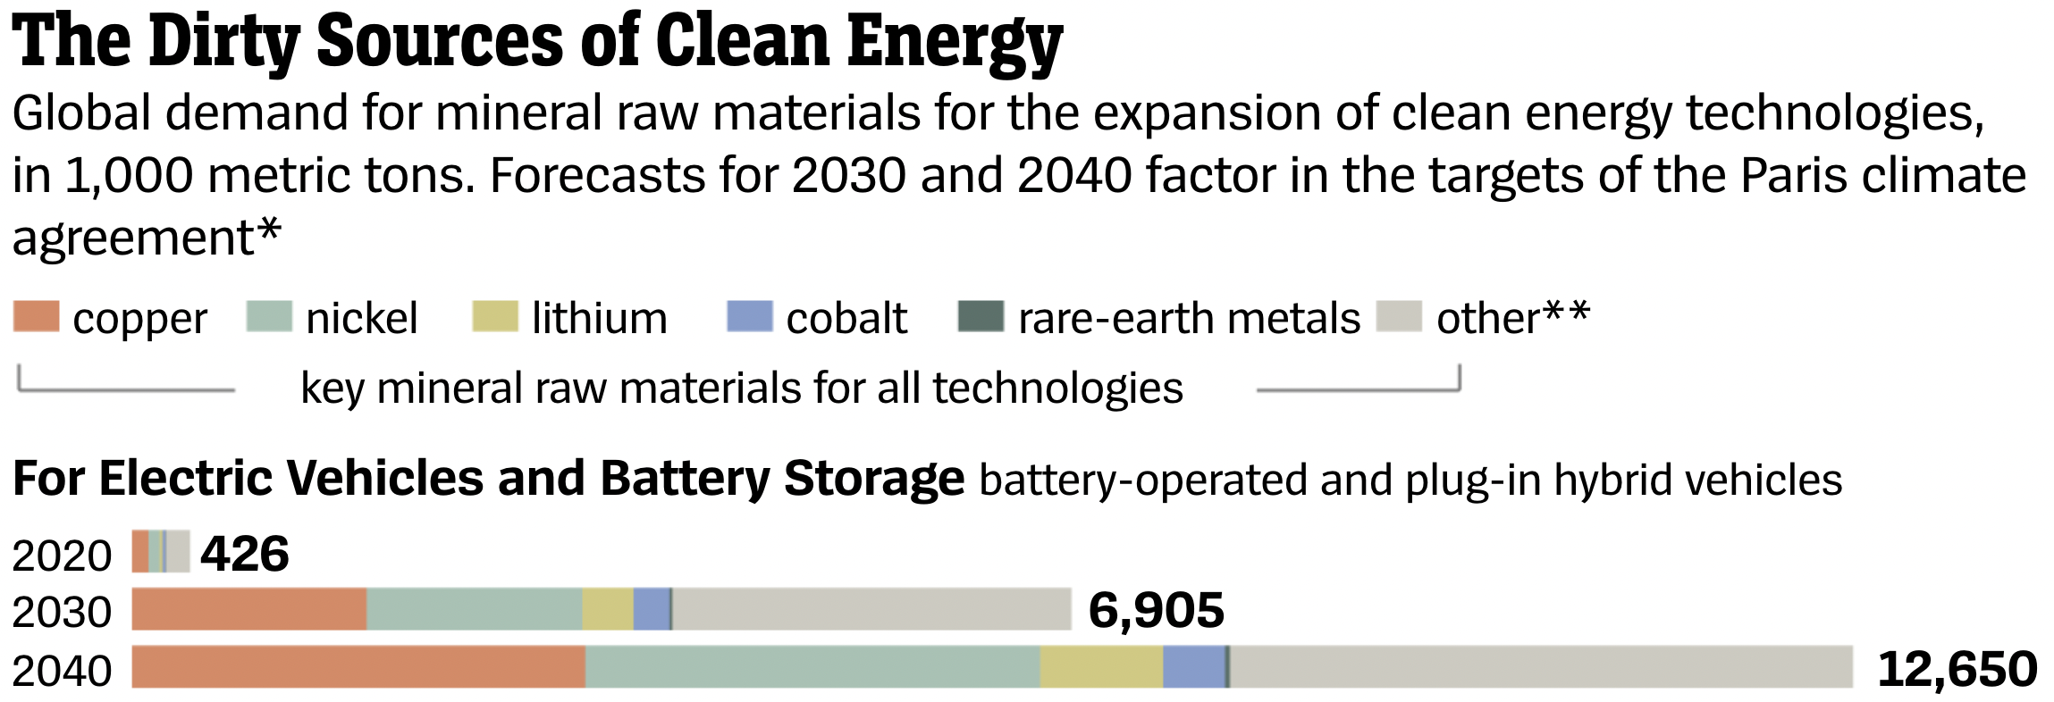
April 2023

Slide 6
April 2023

Slide 7
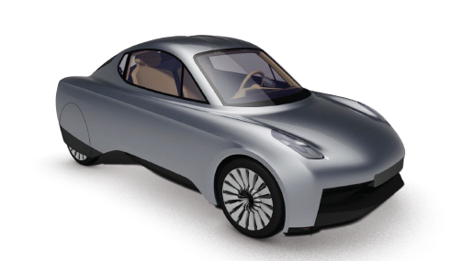
The sale of product
Selling a Vehicle as a product:
Only 40%
Of lifetime revenues to the manufacturer
April 2023
£
£
£

Slide 8
The sale of service
Selling Vehicle as a Service (VaaS):
100%
Of lifetime revenues to the manufacturer
April 2023
£
£
£
£
£
£
£
£
£
£
£
£
£
£
£

Slide 9
Eliminating the economic barrier
Vehicle as a product – price to customer based on build costs
April 2023
Selling service -
Selling cars -
Typical supply chain cost curve

Slide 10
Eliminating the economic barrier
Vehicle as a product – price to customer based on build costs
Vehicle as a service – price to customer based on total lifetime cost
April 2023
Selling service -
Selling cars -
Reward
of efficiency
Typical supply chain cost curve

Slide 11
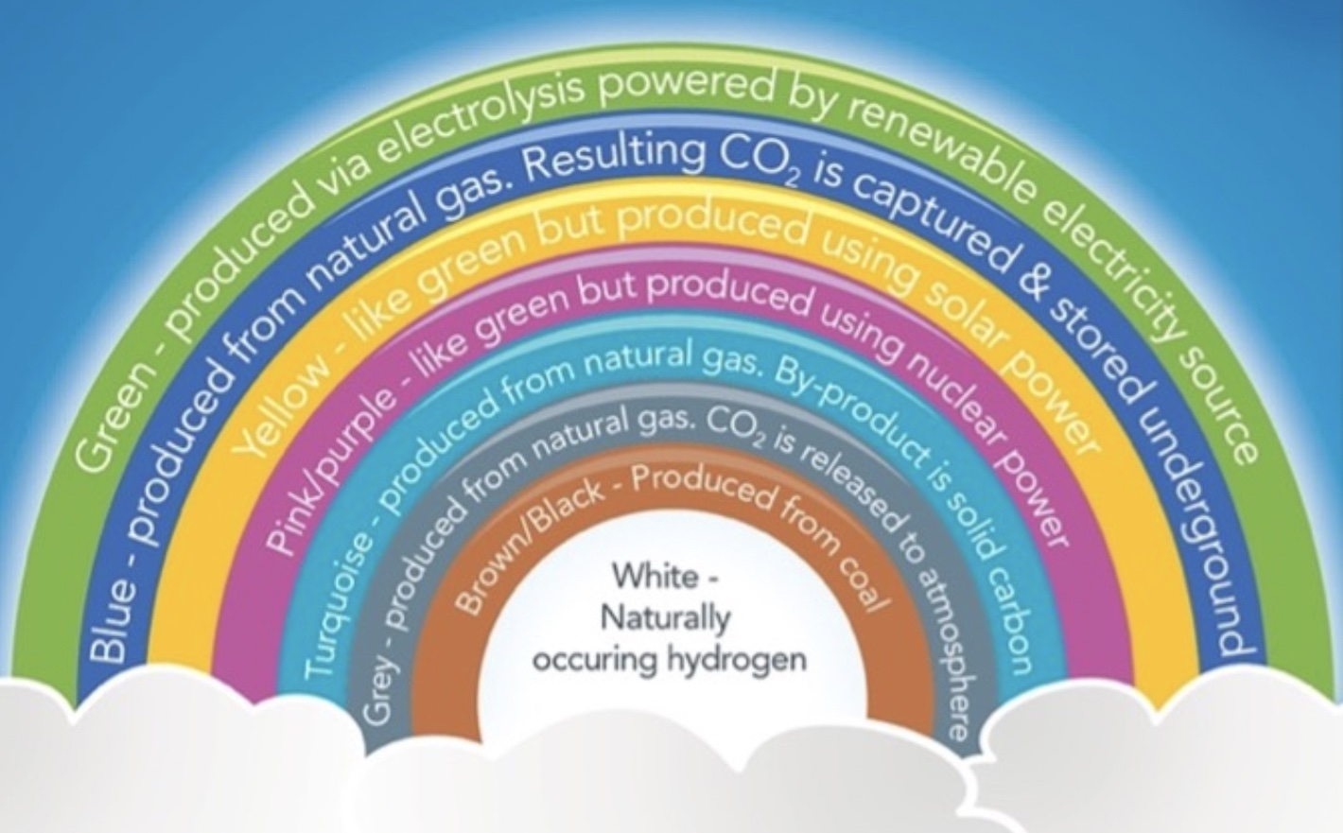
The hydrogen ‘rainbow’
April 2023
Notes:
The end game has to be 100% carbon free H2 but serious concerns about how we are getting there – the rainbow and ‘the only good hydrogen is green hydrogen’. We need a transition strategy to move seamlessly to 1000% green hydrogen but we need to look at the whole system as we do with electricity. Forcing new hydrogen demand and green H2 production into lockstep hobbles the development of both:
Vehicle deployment is harder if we don’t allow cars to tap into the 70M+ tons of grey H2 that we produce annually; who uses which bit, green or grey, is irrelevant.
To achieve equivalent yield to a 10MW electrolyser, using only renewable electricity which is not available 24/7, would need a 16MW electrolyser, increasing capex by over 50%.
Green hydrogen is now being defined as from electrolysis with renewables, rather than zero carbon.
Why is yellow, electrolysis from solar power, defined separately?
And where is hydrogen from biogas? This is carbon negative; biomass releases methane as it decays, which is 85x the GWP of CO2 over 20 years, so extracting the hydrogen and releasing the CO2 eliminates 84 of that 85 fold impact:
H2 from methane is 75% efficient whereas it is considered our cleanest form of fossil-generated electricity at 49%, which brings me back to my first point.
From a whole system perspective, we decarbonise quicker if we use green electricity to displace natural gas from electricity production at 49% efficiency rather than to displace natural gas from hydrogen production at 75% efficiency!

Slide 12
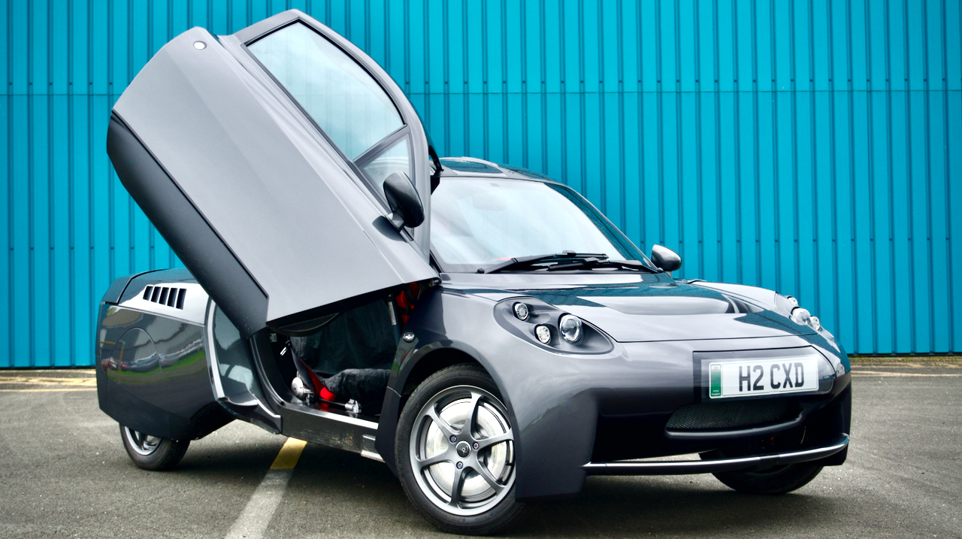
“You never change things by fighting the existing reality. To change something, build a new model that makes the existing model obsolete.”
Buckminster Fuller
Notes:
12
12

